Slide 1
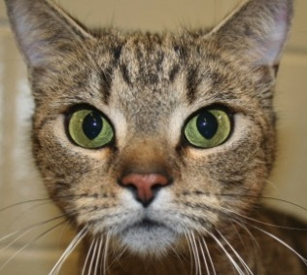
AAV-Vectored Generation of GnRH-Binding Immunoglobulins for Non-Surgical Sterilization of Domestic Cats
Lindsey Marie Vansandt, Danijela Markovic, Marlene L. Biller, Jackie Newsom, Helen Bateman, William F. Swanson, Bruce A. Hay

Slide 2
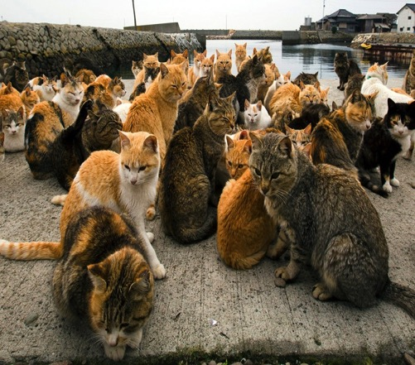
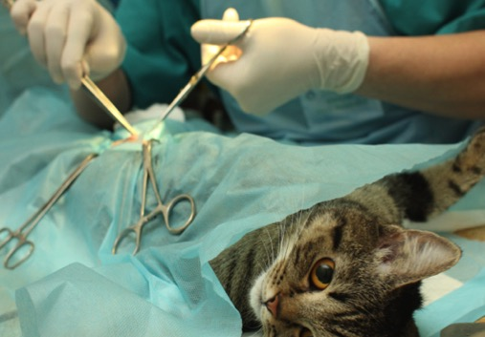
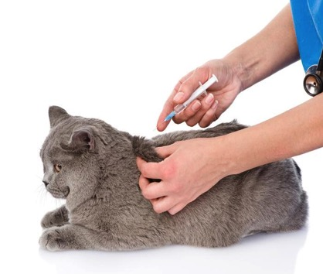
Non-surgical sterilization of domestic cats
80 million free-roaming cats in the United States
2.7 million shelter dogs and cats are euthanized each year
Outdoor cats have negative impacts on birds and other wildlife species
Surgical sterilization common approach
$, labor-intensive, highly-technical
Non-surgical sterilization more field-friendly

Slide 3
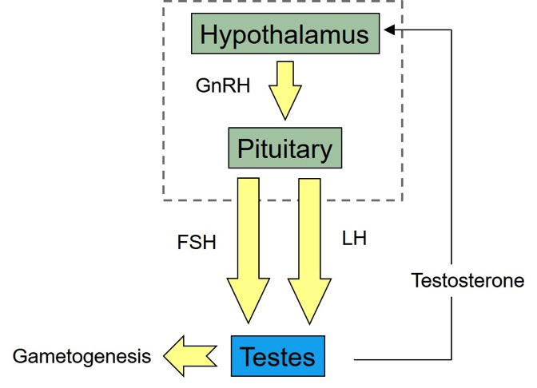
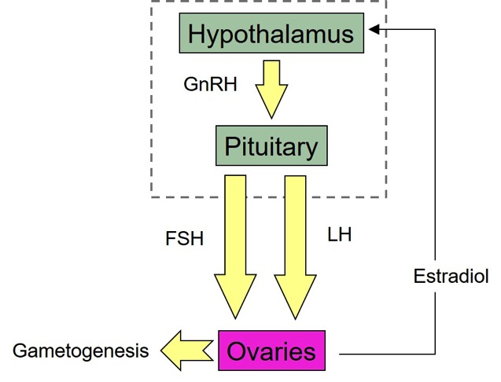
Gonadotropin Releasing Hormone (GnRH)
Master regulator of reproduction

Slide 4
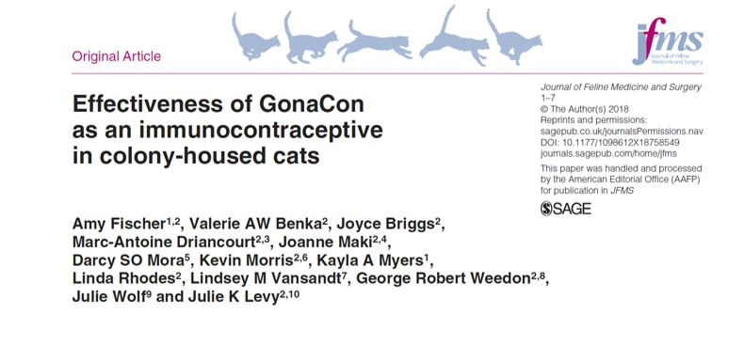
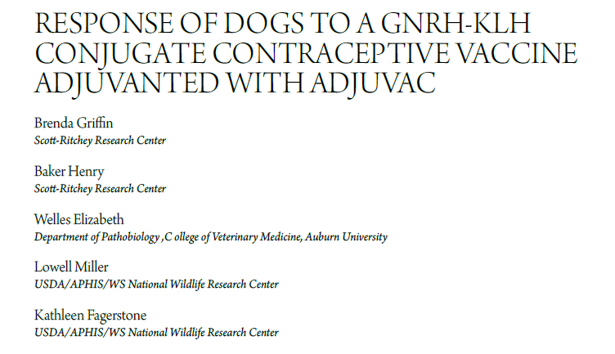
Gonadotropin Releasing Hormone (GnRH)
Master regulator of reproduction
Targeted with immunocontraceptives

Slide 5
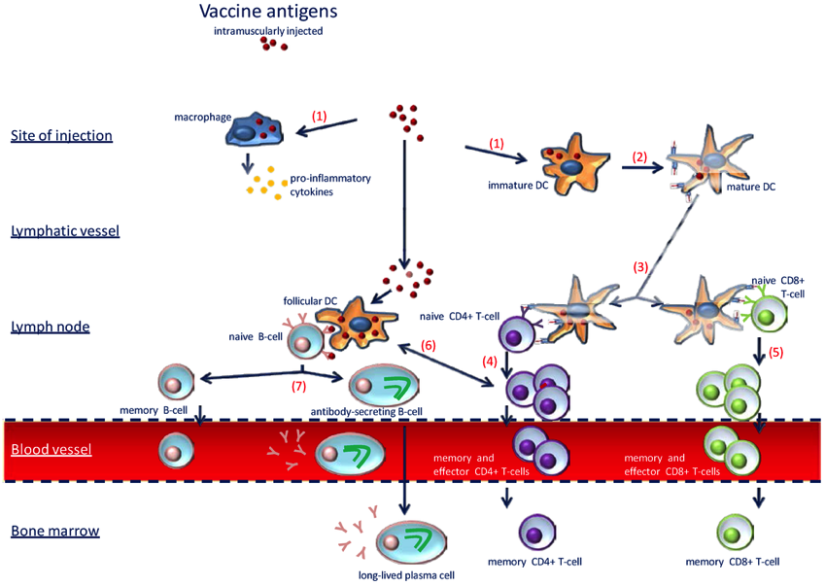
Immune system

Slide 6
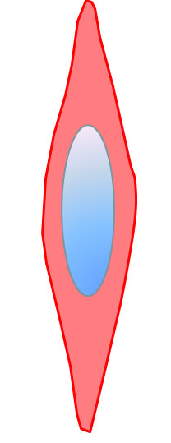
Muscle cells

Slide 7
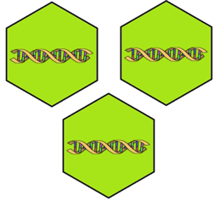
Cat GnRH antibody
DNA
Cat GnRH antibody
protein
Adeno-associated virus (AAV) vector
Notes:
http://www.nature.com/scibx/journal/v1/n28/fig_tab/scibx.2008.669_F1.html

Slide 8
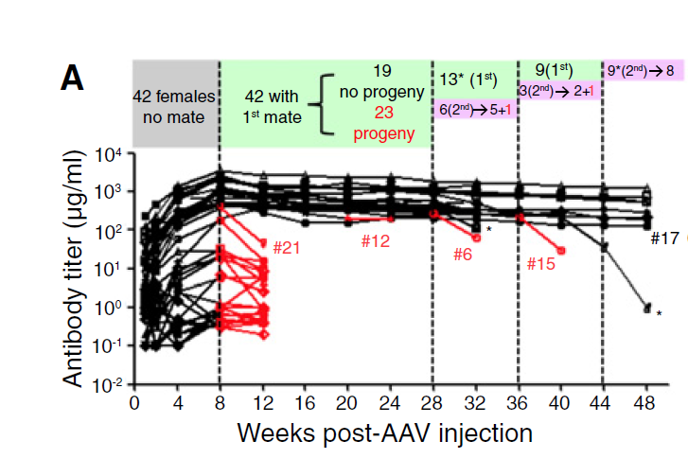
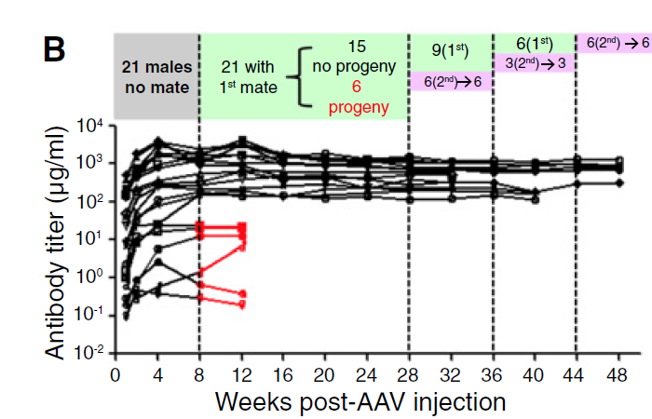
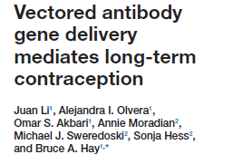
Vectored contraception
Determined sequence of anti-GnRH monoclonal antibody SMI41
Introduced into an AAV2/8 vector
OBJECTIVE: To determine if AAV2/8 vectored expression of SMI41 could induce long-term infertility in the domestic cat (Felis silvestris catus)
Notes:
We used mass spectrometry to determine the protein sequence of the anti-GnRH monoclonal antibody SMI41. Gene synthesized heavy and light chains were shown to produce a highaffinity anti-GnRH antibody and were introduced into an AAV2/8 vector [4], generating AAVSMI41. Viral particles were administered to mice at several doses through injection of the gastrocnemius muscle
A) SMI41 titers in females are plotted over time. Red line segments indicate four-week intervals during which a female became pregnant; black line segments indicate intervals during which no pregnancies occurred. Individuals are labeled as in Table S1. Vertical dashed lines indicate points at which AAV-SMI41 females were introduced to new breeding partners. The number of females maintained with either the fi rst male mating partner (1st mate, green regions), or a second mating partner (2nd, purple rectangles), is indicated. Asterisks identify females who died. Note that some infertile females were euthanized for histology at weeks 32 and 40 (Supplemental Experimental Procedures). (B) SMI41 titers in males, characterized as in (A), but with female mating partners.

Slide 9
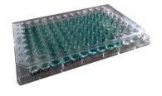
Study design
No injection site reactions, adverse events, or off-target effects observed
3.4x10¹³ viral particles
(n = 3)
(n = 3)
D
W
W
M
M
M
M
M
M
Pre-Tx (4 mo)
Tx (Days 7 – 30)
Post-Tx (Months 1-6)
Notes:
Consistent among the three cats, there were no injection site reactions, adverse events, or off-target effects of the construct throughout the six month post-injection observation period.

Slide 10
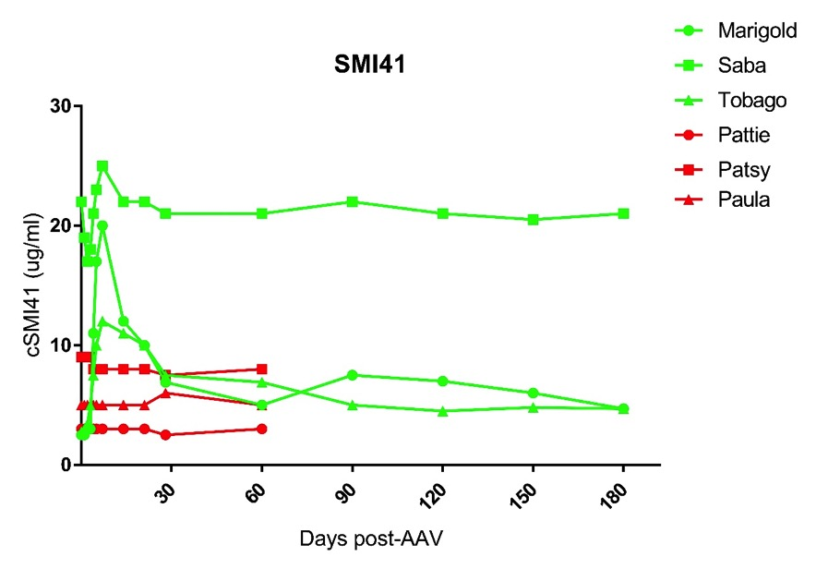
SMI41 antibody production
In the mouse, threshold titer level to produce infertility was 200 µg/ml
Notes:
At three months, serum samples were assessed for GnRH titer levels. As demonstrated in Figure 1, all three cats produced the anti-GnRH antibody. Our results are extremely exciting as this is the first time a cloned antibody has successfully been expressed in the cat. The expression pattern was similar among the treated cats (early peak which settles down to a prolonged plateau phase) and also mimicked the pattern seen in our collaborators’ proof-of-concept mouse study.
However, the overall titer levels are much lower than we had hoped for. Based on the mouse study, we need at least 200 ug/ml of antibody to reliably shut down reproduction. Marigold and Tobago’s levels (green and brown lines, respectively) reached the 10-20 ug/ml level, but then plateaued around 5 ug/ml. Saba’s titer (blue line) peaked and plateaued much higher than the other two cats, but levels were still well below the 200 ug/ml threshold.

Slide 11
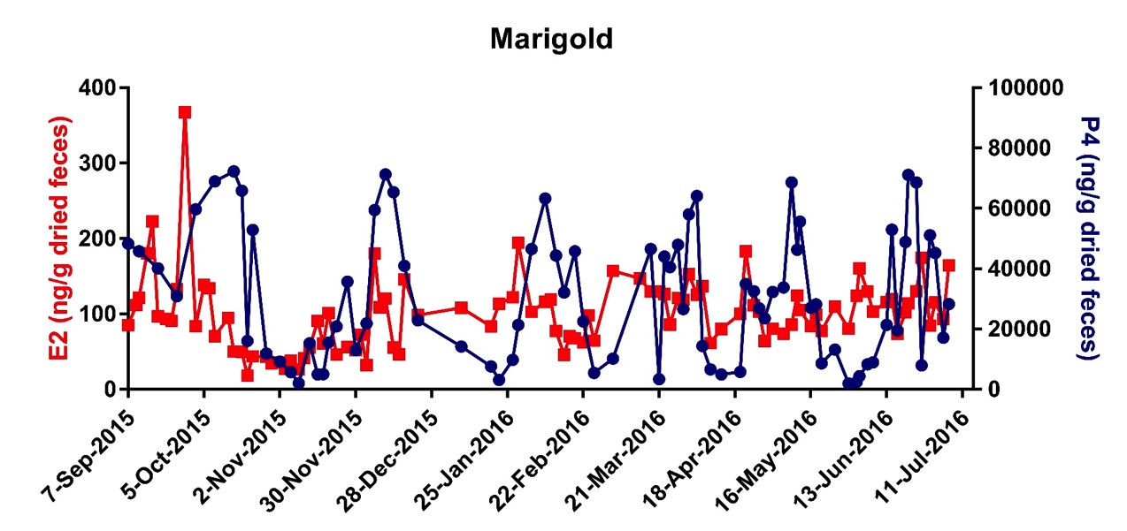
Hormone profiles
Pre-Tx
Tx
Post-Tx

Slide 12
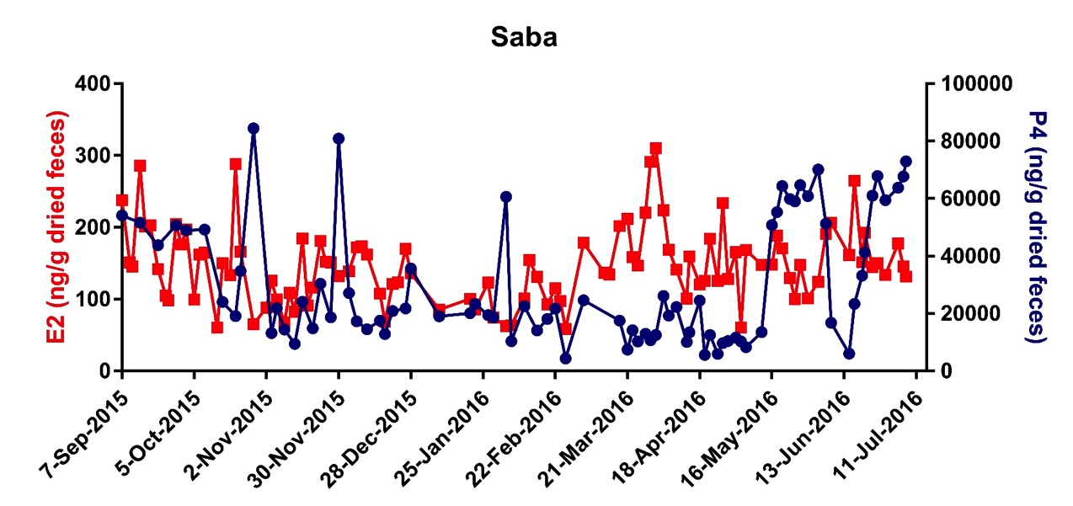
Hormone profiles
Pre-Tx
Tx
Post-Tx

Slide 13
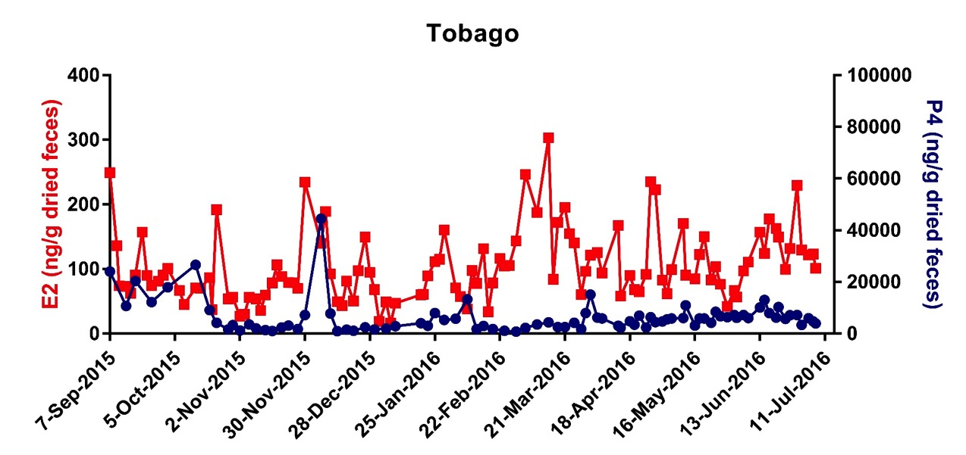
Hormone profiles
Pre-Tx
Tx
Post-Tx

Slide 14
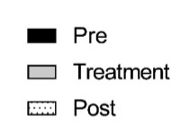
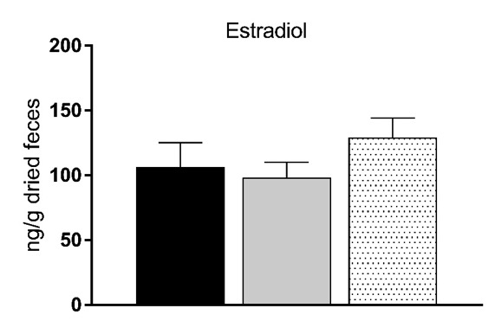
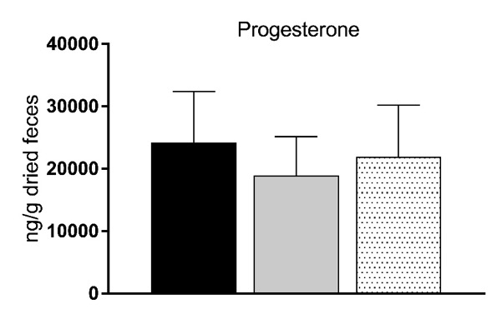
Hormone profiles
P=0.4065
P=0.0914
Notes:
Both E2 and P4 concentrations trended slightly lower during the treatment period, but neither reduction was significant

Slide 15
Anti-SMI41 antibody production
Notes:
Preliminary tests showed the cats were producing antibodies against the framework of SMI41.

Slide 16
Conclusions
Expressed a functional GnRH antibody in the cat using a recombinant AAV-vectored approach
Suspected immunogenicity prevented the threshold titler level to inhibit ovarian cyclicity to be achieved
Notes:
These results highlight both the potential of this approach as well as the need for additional studies. we were able to express a functional GnRH antibody in the cat using a recombinant AAV-vectored approach without comprising the safety or welfare of the animals. However, due to the suspected immunogenicity of the anti-GnRH antibody, the threshold titer level to inhibit ovarian cyclicity could not be achieved.

Slide 17
Acknowledgements

Slide 18
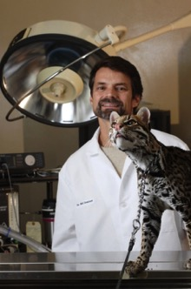
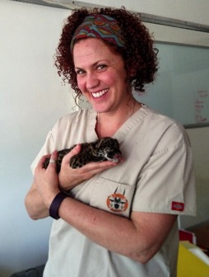
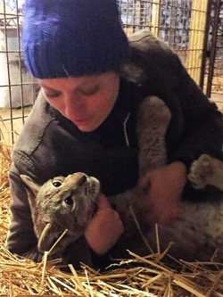
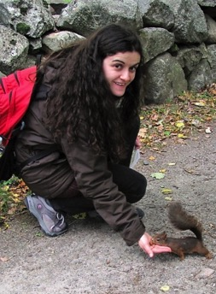
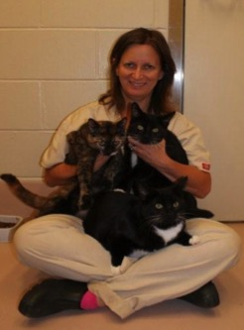
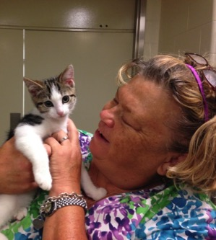
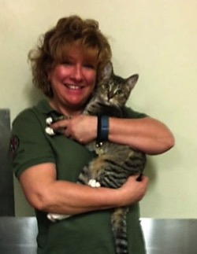
team CAT

Slide 19
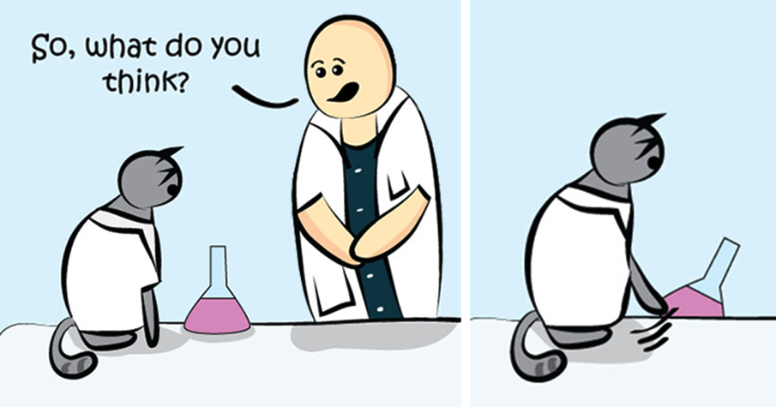
QUESTIONS?

Slide 20
QUESTIONS?

Slide 21
Adeno-associated virus
Requires adenovirus (or herpesvirus) to replicate
Non-pathogenic virus
=

Slide 22
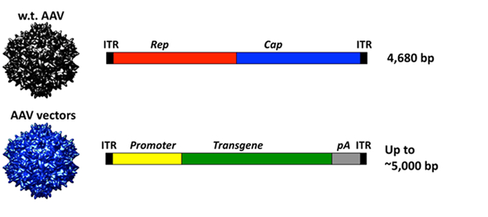
AAV vector
NOT A LIVE VIRUS!!!!!
Parts of AAV
Package DNA
Non-replicative → effects are dose-dependent
Cat GnRH antibody
Notes:
http://www.discoverymedicine.com/Elisa-Masat/2013/06/27/humoral-immunity-to-aav-vectors-in-gene-therapy-challenges-and-potential-solutions/

Slide 23
AAV vector
NOT A LIVE VIRUS!!!!!
Parts of AAV
Package DNA
Non-replicative → effects are dose-dependent
Cannot integrate into the genome
Notes:
http://www.discoverymedicine.com/Elisa-Masat/2013/06/27/humoral-immunity-to-aav-vectors-in-gene-therapy-challenges-and-potential-solutions/

Slide 24
AAV vector safety
Widely used in human gene therapy
38 protocols approved by FDA (Daya and Berns, 2008)
Long-term transgene expression
Lack of immune response or other toxicities
Notes:
AAV has become increasingly common as a vector for use in
human clinical trials (Parkinsons, alzheimers, cystic fibrosis, rheumatoid arthritis). First, almost all other viral vectors lead to an initial burst of transgene expression that commonly disappears after a relatively short time, measured in weeks. AAV transgene expression, on the other hand, frequently persists for years or the life time of the animal

